Slide 1
Lecture # 15-16
Dr. M. Nadeem

Slide 2
FPE Infix To Postfix
Initialize a Stack for operators, output list
Split the input into a list of tokens.
for each token (left to right):
if it is operand: append to output
if it is operator push onto Stack
if it is '(': push onto Stack
if it is ')': pop & append till '('

Slide 3
FPE Infix to Postfix
( ( ( A + B ) * ( C - E ) ) / ( F + G ) )
stack: <empty>
output: []

Slide 4
FPE Infix to Postfix
( ( A + B ) * ( C - E ) ) / ( F + G ) )
stack: (
output: []

Slide 5
FPE Infix to Postfix
( A + B ) * ( C - E ) ) / ( F + G ) )
stack: ( (
output: []

Slide 6
FPE Infix to Postfix
A + B ) * ( C - E ) ) / ( F + G ) )
stack: ( ( (
output: []

Slide 7
FPE Infix to Postfix
+ B ) * ( C - E ) ) / ( F + G ) )
stack: ( ( (
output: [A]

Slide 8
FPE Infix to Postfix
B ) * ( C - E ) ) / ( F + G ) )
stack: ( ( ( +
output: [A]

Slide 9
FPE Infix to Postfix
) * ( C - E ) ) / ( F + G ) )
stack: ( ( ( +
output: [A B]

Slide 10
FPE Infix to Postfix
* ( C - E ) ) / ( F + G ) )
stack: ( (
output: [A B + ]

Slide 11
FPE Infix to Postfix
( C - E ) ) / ( F + G ) )
stack: ( ( *
output: [A B + ]

Slide 12
FPE Infix to Postfix
C - E ) ) / ( F + G ) )
stack: ( ( * (
output: [A B + ]

Slide 13
FPE Infix to Postfix
- E ) ) / ( F + G ) )
stack: ( ( * (
output: [A B + C ]

Slide 14
FPE Infix to Postfix
E ) ) / ( F + G ) )
stack: ( ( * ( -
output: [A B + C ]

Slide 15
FPE Infix to Postfix
) ) / ( F + G ) )
stack: ( ( * ( -
output: [A B + C E ]

Slide 16
FPE Infix to Postfix
) / ( F + G ) )
stack: ( ( *
output: [A B + C E - ]

Slide 17
FPE Infix to Postfix
/ ( F + G ) )
stack: (
output: [A B + C E - * ]

Slide 18
FPE Infix to Postfix
( F + G ) )
stack: ( /
output: [A B + C E - * ]

Slide 19
FPE Infix to Postfix
F + G ) )
stack: ( / (
output: [A B + C E - * ]

Slide 20
FPE Infix to Postfix
+ G ) )
stack: ( / (
output: [A B + C E - * F ]

Slide 21
FPE Infix to Postfix
G ) )
stack: ( / ( +
output: [A B + C E - * F ]

Slide 22
FPE Infix to Postfix
) )
stack: ( / ( +
output: [A B + C E - * F G ]

Slide 23
FPE Infix to Postfix
)
stack: ( /
output: [A B + C E - * F G + ]

Slide 24
FPE Infix to Postfix
stack: <empty>
output: [A B + C E - * F G + / ]

Slide 25
Convert Infix to Postfix
Example-1: A+B*C
symb | Postfix string | opstk
A | A
+ | A | +
B | AB | +
* | AB | + *
C | ABC | + *
 | ABC* | +
 | ABC*+

Slide 26
Convert Infix to Postfix
Example-2: (A+B)*C
symb | Postfix string | opstk
( |  | (
A | A | (
+ | A | ( +
B | AB | ( +
) | AB+
* | AB+ | *
C | AB+C | *
 | AB+C*

Slide 27
Convert Infix to Postfix
Example-3: ( (A-(B+C) ) *D ) $ (E+F)
symb | Postfix string | opstk
( |  | (
( |  | ((
A | A | ((
- | A | ((-
( | A | ((-(
B | AB | ((-(
+ | AB | ((-(+
C | ABC | ((-(+
) | ABC+ | ((-
) | ABC+- | (
* | ABC+- | (*
D | ABC+-D | (*
) | ABC+-D*
$ | ABC+-D* | $
( | ABC+-D* | $(
E | ABC+-D*E | $(
+ | ABC+-D*E | $(+
F | ABC+-D*EF | $(+
) | ABC+-D*EF+ | $
 | ABC+-D*EF+$

Slide 28
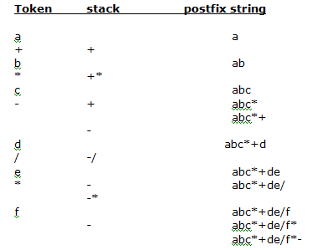
Infix to Postfix some more example
a+b*c-d/e*f

Slide 29
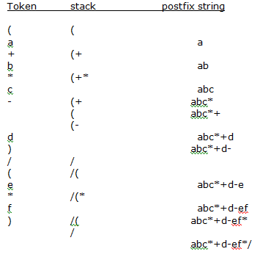
Infix to Postfix some more example
(a+b*c-d)/ (e*f)

Slide 30
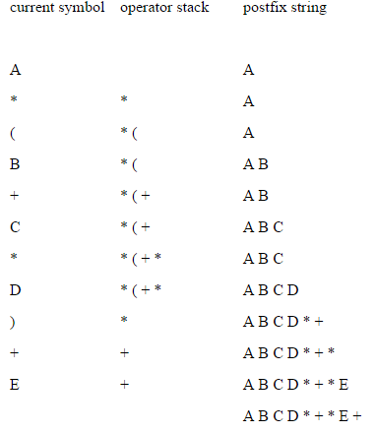
Infix to Postfix some more example
A * (B + C * D) + E

Slide 31
Evaluating postfix expressions (without OpenStack)
1. Scan the expression from left to right.
2. Each time an operator is encountered, apply it to the immediately preceding operands.
3. Replace the operands and the operator with the result.
4. Continue scanning to the right

Slide 32
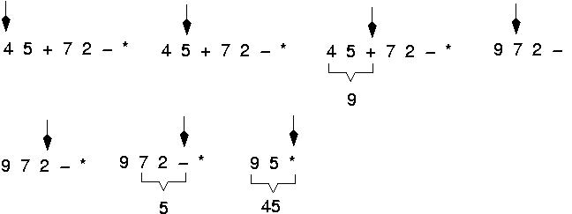
Example: postfix expressions Evaluation

Slide 33
Evaluating a postfix expression (With stack)
Initialise an empty stack
While token remain in the input stream
Read next token
If token is a number, push it into the stack
Else, if token is an operator, pop top two tokens off the stack,apply the operator, and push the answer back into the stack
Pop the answer off the stack.

Slide 34
Evaluating postfix expressions (with OpenStack)
Step 1 − scan the expression from left to right
Step 2 − if it is an operand push it to stack
Step 3 − if it is an operator pop operand from stack and perform operation
Step 4 − store the output of step 3, back to stack
Step 5 − scan the expression until all operands are consumed
Step 6 − pop the stack and perform operation

Slide 35
Algorithm to evaluate postfix expressions
1. Initialize an empty stack.
2. Repeat the following until the end of expression.
a. Get the next token(const, variable, operator) in RPN expression.
b. If the token is an operand, push it onto the stack. If it is an operator, then do the following
i. Pop the top two values from the stack. If the stack does not contain two items, an error due to a malformed RPN expression has occurred, and evaluation terminated.
ii. Apply the operator to these two values.
iii. Push the resulting value back onto the stack.
3. When the end of expression is encountered, its value is on top of the stack (and, in fact , must be the only value in the stack)
Notes:
Malformed = abnormally formed

Slide 36
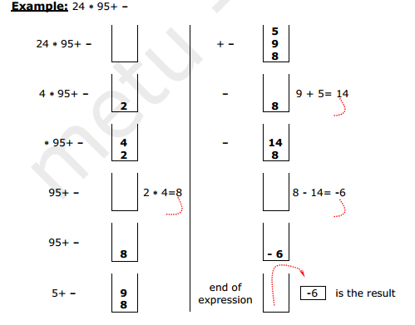
Evaluate postfix expressions
Notes:
Quiz = 9 3 / 4 7 6 * + -

Slide 37
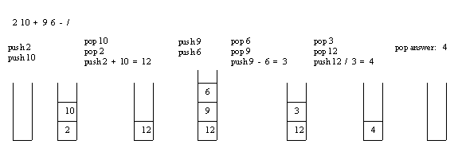
Evaluating Postfix Expression
Example: Consider the postfix expression, 2 10 + 9 6 - /, which is (2 + 10) / (9 - 6) in infix, the result of which is 12 / 3 = 4.
The following is a trace of the postfix evaluation algorithm for the postfix expression:

Slide 38
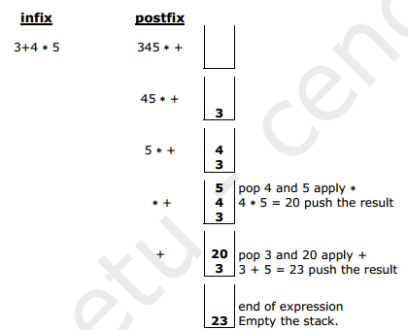
Evaluating postfix expressions (Using OpenStack)

Slide 39
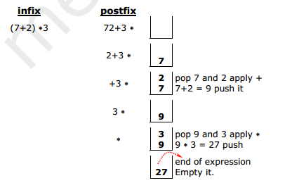
Evaluating postfix expressions (Using OpenStack)

Slide 40
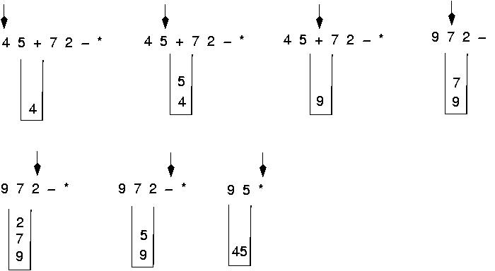
Postfix expressions evaluation Algorithm using stacks

Slide 41
Evaluation example: 623+-382/+*2^3+ Postfix expression evaluation algo using stack
Symbol opnd1 opnd2 value opndstk
6 6
2 6,2
3 6,2,3
+ 2 3 5 6,5
- 6 5 1 1
3 6 5 1 1,3

Slide 42
Evaluate- 623+-382/+*2^3+
Symbol opnd1 opnd2 value opndstk
8 6 5 1 1,3,8
2 6 5 1 1,3,8,2
/ 8 2 4 1,3,4
+ 3 4 7 1,7
* 1 7 7 7
2 1 7 7 7,2
^ 7 2 49 49
3 7 2 49 49,3
+ 49 3 52 52

Slide 43
Another example of Postfix Expression Evaluation
Example:
Postfix Expression: 6 2 3 + - 3 8 2 / + * 2 $ 3 +
symb | opnd1 | opnd2 | value | opndstk
6 |  |  |  | 6
2 |  |  |  | 6,2
3 |  |  |  | 6,2,3
+ | 2 | 3 | 5 | 6,5
- | 6 | 5 | 1 | 1
3 | 6 | 5 | 1 | 1,3
8 | 6 | 5 | 1 | 1,3,8
2 | 6 | 5 | 1 | 1,3,8,2
/ | 8 | 2 | 4 | 1,3,4
+ | 3 | 4 | 7 | 1,7
* | 1 | 7 | 7 | 7
2 | 1 | 7 | 7 | 7,2
$ | 7 | 2 | 49 | 49
3 | 7 | 2 | 49 | 49,3
+ | 49 | 3 | 52 | 52

Slide 44
Evaluation of prefix expressions

Slide 45
Evaluation of prefix expressions (Without open stack)
1. Scan the expression from right to left.
2. Each time an operator is encountered, apply it to the two operands that immediately follow the operator.
3. Replace the operands and the operator with the result.
4. Continue scanning the expression to the left.

Slide 46
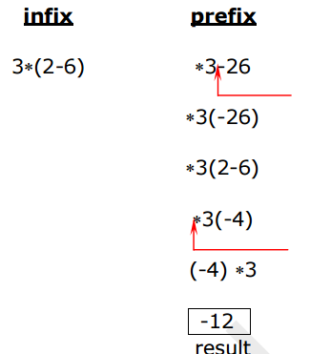
Evaluation of prefix expressions (Without open stack)-Example

Slide 47
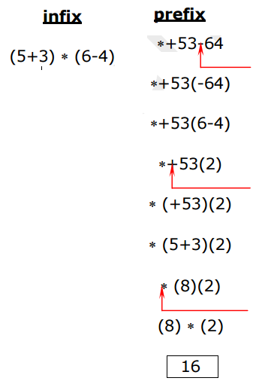
Evaluation of prefix expressions (Without open stack) -Example

Slide 48
Evaluating Prefix Expression (With open stack)
Start scanning the string from the right one character at a time.
If it is an operand, push it in stack.
If it is an operator, pop opnd1, opnd2 and perform the operation, specified by the operator. Push the result in the stack.
Repeat these steps until arr of input prefix strings ends.
Example: Evaluate the following prefix notation
-*+4325

Slide 49
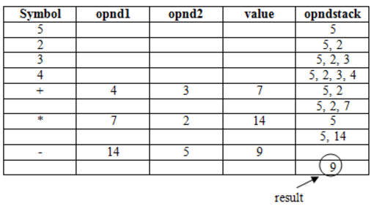
Evaluating Prefix Expression (With open stack)
-*+4325

Slide 50
Infix to Prefix Conversion

Slide 51
Infix to prefix (by reversing)
((A-B)+C*(D+E))-(F+G)
Now reading expression from right to left and pushing operators into stack and variables to output stack

Slide 52
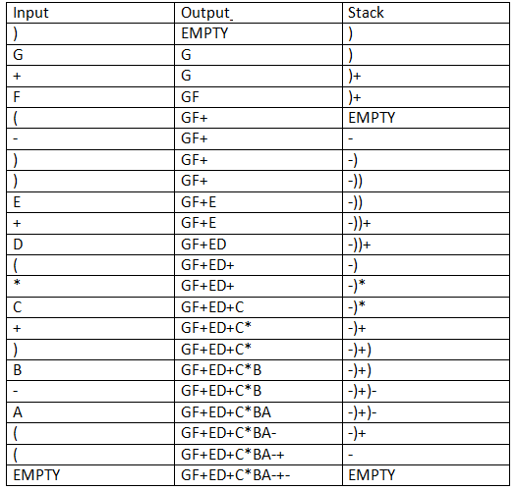
Infix to prefix
((A-B)+C*(D+E))-(F+G)
Output is:(Reverse)
-+-AB*C+DE+FG
Notes:
-+-AB*C+DE+FG

Slide 53
Infix to prefix conversion
Expression = (A+B^C)*D+E^5
Step 1. Reverse the infix expression. 5^E+D*)C^B+A(
Step 2. Make Every '(' as ')' and every ')' as '(' 5^E+D*(C^B+A)
Step 3. Convert expression to postfix form.

Slide 54
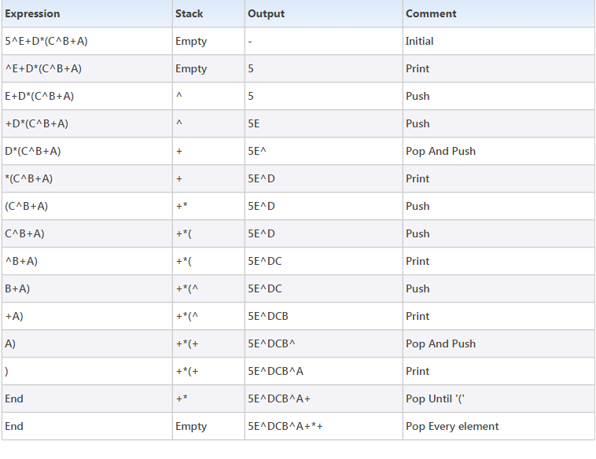
Infix to prefix conversion
(implement Step 3.)

Slide 55
Infix to prefix conversion
Step 4. Reverse the expression. +*+A^BCD^E5
Result
+*+A^BCD^E5

Slide 56
Infix to prefix conversion(Right to left) w/o stack
(a–b)/c*(d + e – f / g)
step 1: (a-b)/c*(d+e- /fg)
step 2: (a-b)/c*(+de - /fg)
step 3: (a-b)/c * -+de/fg
Step 4: -ab/c * -+de/fg
step 5: /-abc * -+de/fg
step 6: */-abc-+de/fg
This is prefix notation.

Slide 57
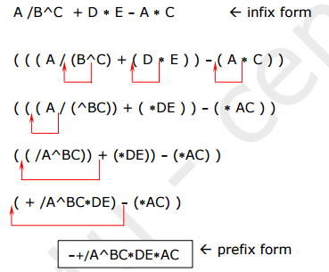
Infix TO Prefix Example: (Without open stack)

Slide 58
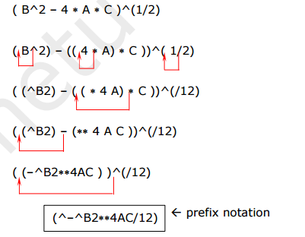
Infix TO Prefix Example (Without open stack)

Slide 59
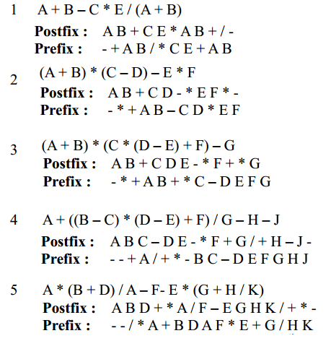
Practice (infix to prefix n postfix)

